Slide 1
Clean Code
Part I – Dependency Injection

Slide 2
No [Clean Code]
Notes:
Anything related to design / architecture
- OO
- Design patterns
- TDD
- Domain driven design
- Tools

Slide 3
Agenda
Robert Martin & Clean Code
SOLID
Dependency Injection
Resources
QA
What’s Next?

Slide 4

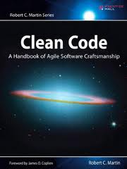

Robert C. Martin - Uncle Bob

Slide 5
SOLID
OOP and design
Maintainability / Extensibility
Clean code – remove code smells
Refactoring
Typically used with TDD
Solid is not everything
Solid is not new

Slide 6
Single Responsibility Principle
An object should have only a single responsibility.

Slide 7
Open/closed Principle
Open for extension, but closed for modification

Slide 8
Liskov Substitution Principle
Objects in a program should be replaceable with instances of their subtypes without altering the correctness of that program

Slide 9
Interface Segregation Principle
Many client specific interfaces are better than one general purpose interface

Slide 10
Dependency Inversion Principle
Depend upon Abstractions. Do not depend upon concretions.

Slide 11
DI

Slide 12
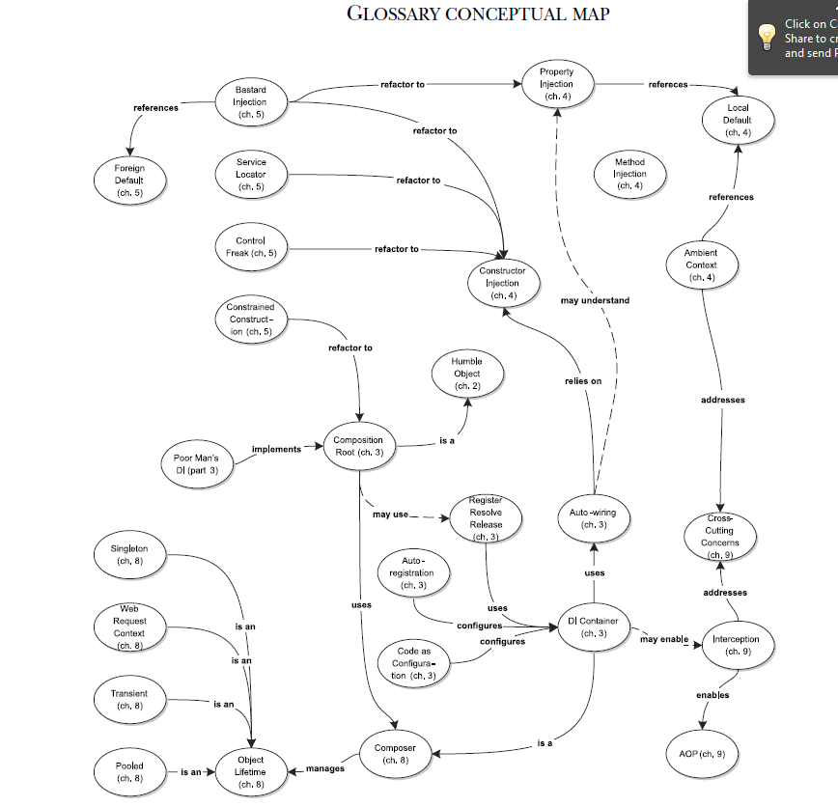

Slide 13
Why Choose DI
DI is practical and interesting
We touched a bit, but still a long way to go
We will have to work on it in the future

Slide 14
DI
Definition: Dependency Injection is a set of software design principles and patterns that enable us to develop loosely coupled code.
Loose coupling makes code extensible, and extensibility makes it maintainable.

Slide 15
Misconceptions about DI
DI is only relevant for late binding
DI is only relevant for unit testing
DI is a sort of Abstract Factory on steroids
DI requires a DI container

Slide 16
DEMO

Slide 17
Benefit of DI
Late binding
dynamic replacement
Extensibility
Loose coupling enables OCP
The only place to modify the code is the application’s entry point – The Composition Root
Parallel development
Maintainability
Testability
Dynamically replace with Test Doubles

Slide 18
Inject or Not
Seam – the place for DI
Stable dependencies (such as CLR types)
The class / module already exists
Expect backward compatibilities
Deterministic outcomes
Never expect to replace them
Volatile dependencies
Requires setup and configure a runtime environment
Still in development
Not installed in all machines
Contains nondeterministic behavior

Slide 19
DI Containers
DI Container – Automate composing objects and managing lifetimes
Poor Man’s DI – Do everything manually
General functionalities
Resolve object graphs
Auto-wiring – automatically compose an object graph from maps between abstraction and concrete types

Slide 20
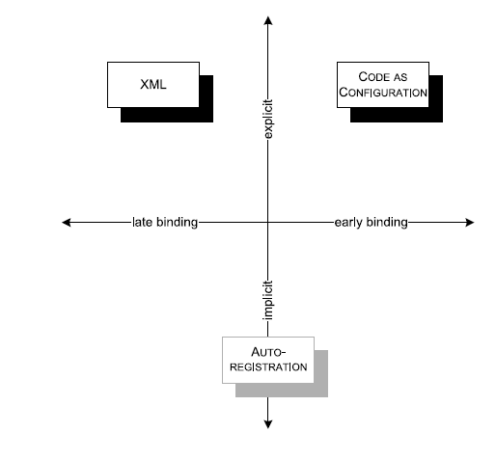

Slide 21
Configure Containers
XML configuration
Code as configuration
Auto-registration
Convention over Configuration
Notes:
string connectionString =
ConfigurationManager.ConnectionStrings
["CommerceObjectContext"].ConnectionString;
var a = typeof(SqlProductRepository).Assembly;
builder.RegisterAssemblyTypes(a)
.Where(t => t.Name.StartsWith("Sql"))
.As(t => t.BaseType)
.WithParameter("connString", connectionString);
builder.RegisterAssemblyTypes(typeof(BasketService).Assembly)
.Where(t => t.Name.EndsWith("Service"))
.AsImplementedInterfaces();

Slide 22
DI Container Patterns
Composition Root
A COMPOSITION ROOT is a (preferably) unique location in an application where modules are composed together.
As close to application’s entry point as possible
A DI container should only be referenced from Composition Root
Last Responsible Moment – Lean
Performance is not an issue
Configure container once, resolve for each incoming request, for request-based app
Example:
Console – Main
ASP.NET – Application_Start (Global.asax)
WCF – custom ServiceHostFactory

Slide 23
DI Container Patterns (CON’T)
Register – Resolve – Release
Must be used in sequence
No re-config

Slide 24
DI Patterns

Slide 25
DI Pattern Catalog
Constructor Injection
Property Injection
Method Injection
Ambient Context

Slide 26
Constructor Injection
Guarantee that a necessary Dependency is always available
Your default choice
If possible, constrain to a single constructor
~ Some frameworks make using Constructor Injection difficult

Slide 27
Property Injection – setter injection
Enable DI as an option
A good Local Default is available
Change the dependency in the middle time?

Slide 28
Method Injection
Inject a Dependency into a class when it’s different for each operation
Often represent context information
Be very useful when building a framework

Slide 29
Ambient Context
Make a Dependency available to every module without polluting every API with Cross-Cutting Concerns
A static public accessor
Associated with thread / request / app-domain
Can be issues with ASP.NET
Condition
Need to context to be queryable
A proper local default exists
Must be guaranteed available

Slide 30
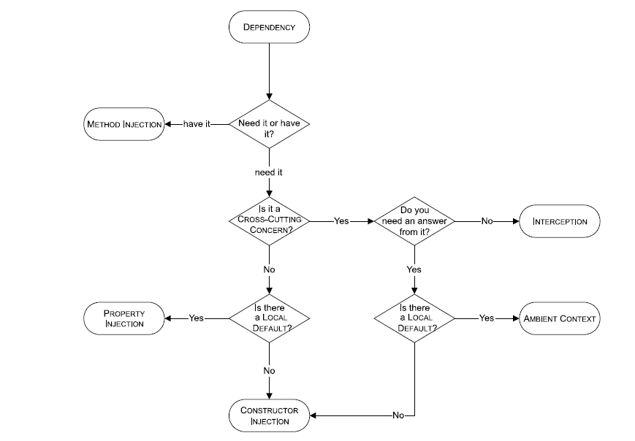

Slide 31
Anti-Patterns

Slide 32
DI Anti-patterns
Control Freak
Bastard Injection
Constrained Construction
Service Locator

Slide 33
Control Freak
DEPENDENCIES are controlled directly, as opposed to INVERSION OF CONTROL
Newing up a dependency
Concrete Factory doesn’t help

Slide 34
Bastard Injection
FOREIGN DEFAULTS are used as default values for DEPENDENCIES
It enables Testability, but …
Constructor overloads become redundant

Slide 35
CONSTRAINED CONSTRUCTION
Constructors are assumed to have a particular signature
For the purpose of late-binding (via Reflection)
E.g. Constrain repository implementation must have a connection string as its constructor’s parameter
Refactoring
Abstract Factory

Slide 36
SERVICE LOCATOR
An implicit service can serve DEPENDENCIES to consumers but isn’t guaranteed to do so
Introduced by Martin Fowler
Anti-pattern ?
One more dependency to the service locator itself
Parameterless constructor ?

Slide 37
DI Dimensions

Slide 38
Three Dimensions of DI
Object Composition
Configuration file
Code as configuration
DI container
Lifetime Management
Giving up control of a Dependency, also means giving up control of its lifetime
Interception
Apply cross-cutting concerns

Slide 39
Object Composition

Slide 40
ASP.NET MVC
Extensibility
IControllerFactory
IDependencyResolver

